Slide 1
CS2106 Tutorial 03
Process Scheduling
T01/T02

Slide 2
Recap

Slide 3
Scheduling in OS
Problems with having multiple processes
Which thread should be chosen to run?
Scheduler
Part of OS that make scheduling decision
Scheduling algorithm
The algorithm used by scheduler to select the next process

Slide 4
Process Behavior
A typical process goes through phases of:
CPU-Activity
Computation (e.g. number crunching)
Compute-Bound Process spends majority of its time here
IO-Activity
Requesting and receiving service from I/O devices (e.g. read/write to file)
IO-Bound Process spends majority of its time here

Slide 5
Batch Processing Systems
No user interaction required, no need to be responsive
Criteria
Turnaround time
Total time taken (finish time - arrival time)
Related to waiting time
Throughput
Rate of task completion
CPU utilization
Non-preemptive scheduling is predominant

Slide 6
Scheduling for Batch Processing Systems
First-Come First Served
Run the first task until it is done or blocked
No starvation
Shortest Job First
Run the task with the smallest total CPU time
Bias to short jobs
Shortest Remaining Time
Run the task with shortest remaining time
Preemptive

Slide 7
Interactive Systems
With active user interacting with system
Should be responsive: low and consistent in response time
Criteria
Response time
Time between request and response by system
Predictability
Variation in response time
Preemptive scheduling algorithms are used to ensure good response time
Scheduler needs to run periodically

Slide 8
Timer & Time Quantum
Interval of Timer Interrupt
Generated by Advanced Programmable Interrupt Controller (1~10ms)
OS scheduler is invoked on every timer interrupt
Time Quantum
Execution duration given to a process
Could be constant or variable among the processes
Must be multiples of interval of timer interrupt

Slide 9
Scheduling for Interactive Systems
Round Robin
Run the first task from FIFO queue until:
Time quantum elapsed
Task gives up/blocks
Preemptive version of FCFS
Timer interrupt will check on quantum expiry
Priority Based
Assign a priority value to all tasks
Run the task with highest priority value

Slide 10
Scheduling for Interactive Systems
Multi-level Feedback Queue
Minimize both response time for I/O bound processes and turnaround time for CPU bound processes
Priority Setting /Changing rules
New job ➔ High priority
Fully utilize time quantum ➔ Priority reduced
Give up/block before time quantum finishes ➔ Priority retained
Lottery Scheduling

Slide 11
Question 1

Slide 12
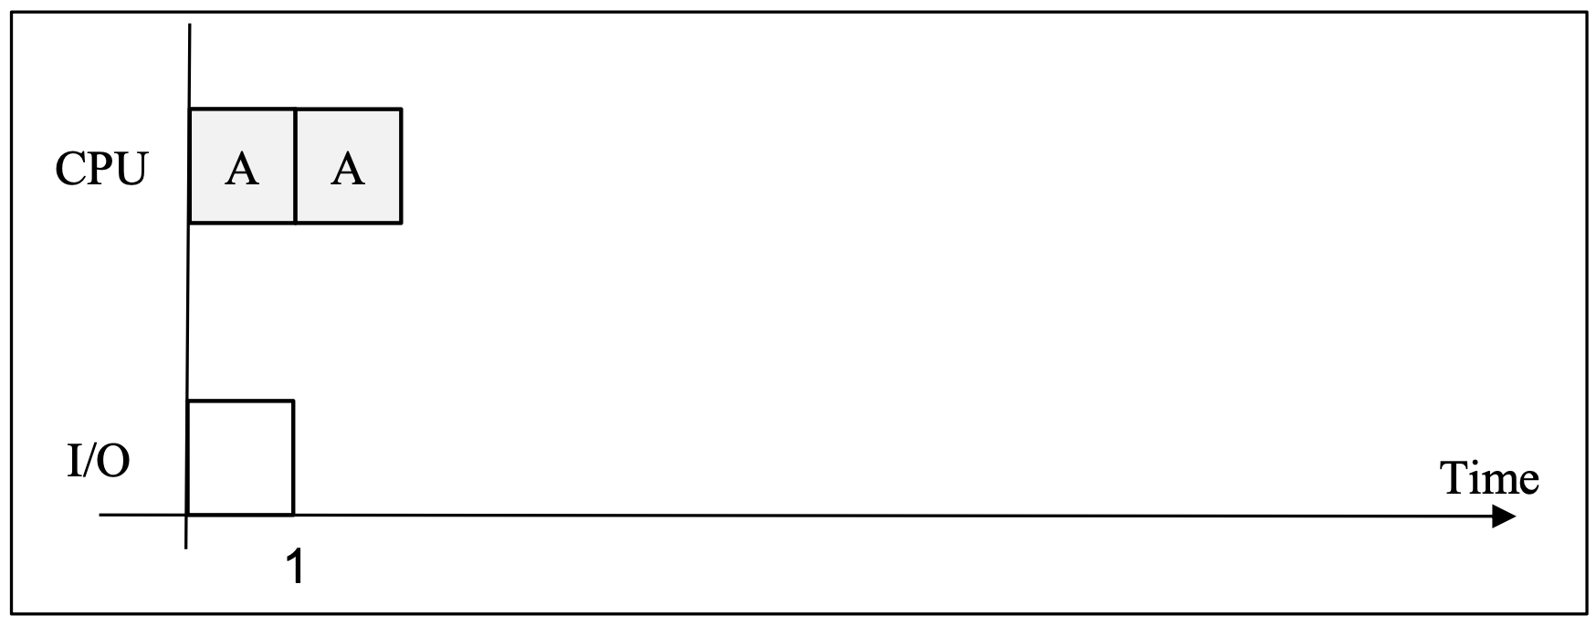
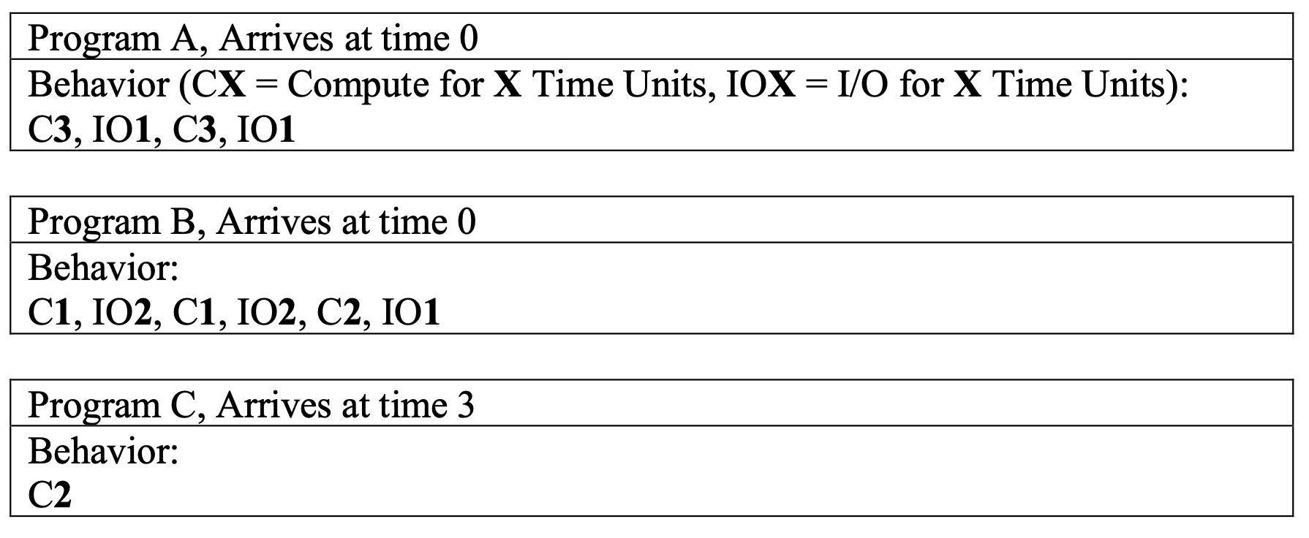

Question 1a - FCFS

Slide 13

Question 1a - FCFS
Ready Queue
B
A

Slide 14

Question 1a - FCFS
Ready Queue
B
C
A
C arrives, A finished CPU

Slide 15

Question 1a - FCFS
Ready Queue
C
A
A
B
A
A finishes I/O and join the queue

Slide 16

Question 1a - FCFS
Ready Queue
A
B
A
B
C
C
A
B
B
B finishes I/O and join the queue

Slide 17

Question 1a - FCFS
Ready Queue
B
A
B
C
C
A
A
A
A
B
B

Slide 18

Question 1a - FCFS
Ready Queue
A
B
C
C
A
A
A
B
A
B
B
A

Slide 19

Question 1a - FCFS
Ready Queue
A
B
C
C
A
A
A
B
B
B
A
B
B
A
B
B
B

Slide 20
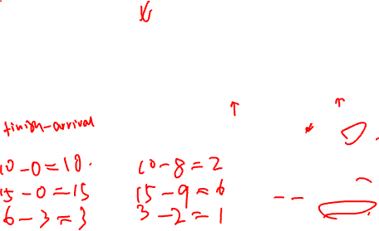
Question 1b - FCFS
A
B
C
C
A
A
A
B
B
B
A
B
B
A
B
B
B
3
6
9
12
15
 | Turnaround time | Waiting time
A
B
C

Slide 21
Question 1b - FCFS
A
B
C
C
A
A
A
B
B
B
A
B
B
A
B
B
B
3
6
9
12
15
 | Turnaround time | Waiting time
A | 10 - 0 = 10 | 10 - 8 = 2
B | 15 - 0 = 15 | 15 - 9 = 6
C | 6 - 3 = 3 | 3 - 2 = 1

Slide 22
Question 1c - Round Robin

Slide 23
Question 1c - Round Robin
Ready Queue
B
Time quantum reached

Slide 24

Question 1c - Round Robin
Ready Queue
A
C
B
C arrives

Slide 25

Question 1c - Round Robin
Ready Queue
C
B
A
B

Slide 26

Question 1c - Round Robin
Ready Queue
B
A
B
A
C
C
B
B
A

Slide 27

Question 1c - Round Robin
Ready Queue
A
B
A
C
C
B
B
B
A

Slide 28

Question 1c - Round Robin
Ready Queue
B
A
Assumption made: I/O finished task joins the queue before the task that hits TQ limit
B
A
C
C
B
A
A
B
B
A
B
B

Slide 29

Question 1c - Round Robin
Ready Queue
B
A
C
C
B
A
A
B
B
A
B
B
A
B
B
B
A

Slide 30

Question 1d - Round Robin
*response time = the time difference between the arrival time and the first time when the task receives CPU time.
B
A
C
C
B
A
A
B
B
A
B
B
A
B
B
B
A
3
6
9
12
 | Response time
A
B
C

Slide 31
Question 1d - Round Robin
one of the strength of pre-emptive scheduling. With FIFO ordering, it is guaranteed that a task will get its time quantum in a finite amount of time (i.e. number of tasks arrived earlier).
B
A
C
C
B
A
A
B
B
A
B
B
A
B
B
B
A
3
6
9
12
 | Response time
A | 0
B | 2 - 0 = 2
C | 4 - 3 = 1

Slide 32
Question 2

Slide 33

Question 2 - Multi-Level Feedback Queue (MLFQ)
Describe the scheduling behavior:
a. (Change of heart) A process with a lengthy CPU-intensive phase followed by I/O- intensive phase.

Slide 34
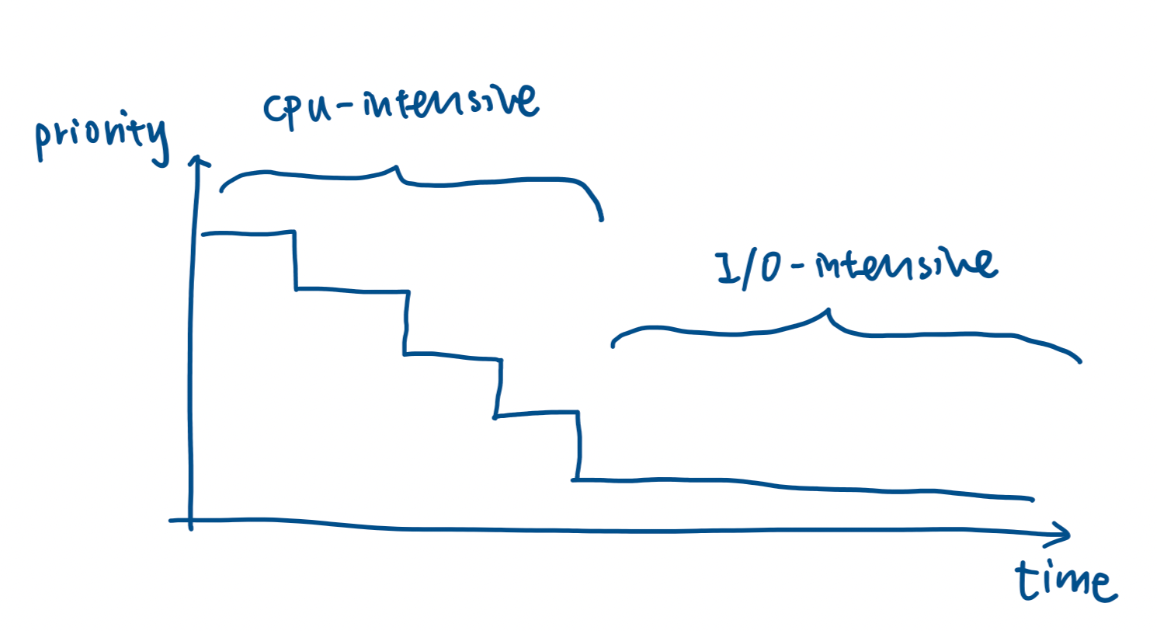

Question 2 - Multi-Level Feedback Queue (MLFQ)
Describe the scheduling behavior:
a. (Change of heart) A process with a lengthy CPU-intensive phase followed by I/O- intensive phase.
The process can sink to the lowest priority during the CPU intensive phase.
With the low priority, the process may not receive CPU time in a timely fashion during the I/O phase
And this degrades the responsiveness.

Slide 35
Question 2 - Multi-Level Feedback Queue (MLFQ)
Describe the scheduling behavior:
b. (Gaming the system) A process repeatedly gives up CPU just before the time quantum lapses.

Slide 36
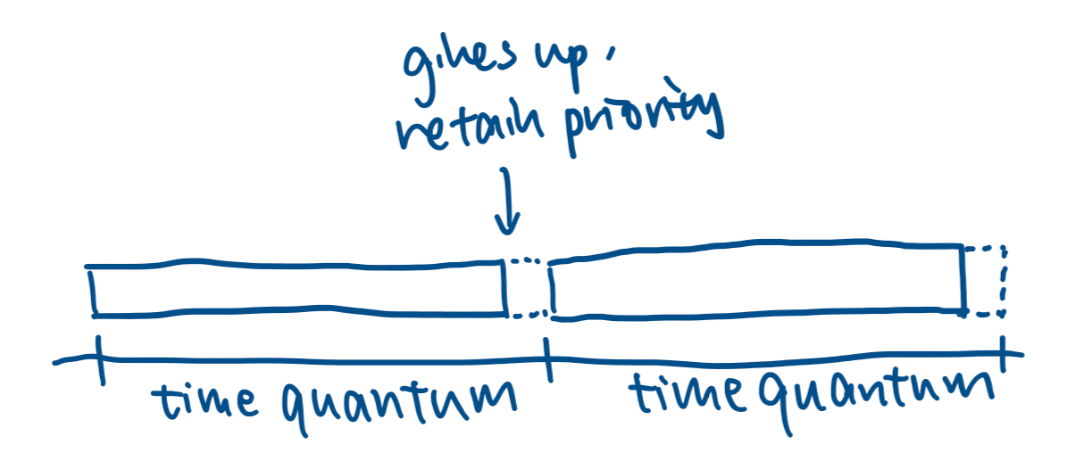

Question 2 - Multi-Level Feedback Queue (MLFQ)
Describe the scheduling behavior:
b. (Gaming the system) A process repeatedly gives up CPU just before the time quantum lapses.
If a process gives up / blocks before the time quantum lapses, it will retain its priority.
Since all processes enter the system with the highest priority, a process can keep its high priority indefinitely by using this trick and receive disproportionately more CPU time than other processes.

Slide 37
Question 2 - Multi-Level Feedback Queue (MLFQ)
The following are two simple tweaks. For each of the rules, identify which case (a or b above) it is designed to solve, then briefly describe the new scheduling behavior.
i. (Rule – Accounting matters) The CPU usage of a process is now accumulated across time quanta. Once the CPU usage exceeds a single time quantum, the priority of the task will be decremented.

Slide 38
Question 2 - Multi-Level Feedback Queue (MLFQ)
The following are two simple tweaks. For each of the rules, identify which case (a or b above) it is designed to solve, then briefly describe the new scheduling behavior.
i. (Rule – Accounting matters) The CPU usage of a process is now accumulated across time quanta. Once the CPU usage exceeds a single time quantum, the priority of the task will be decremented.
This tweak fixes case (b).
The trick in (b) works because the scheduler is “memory- less”, i.e. the CPU usage is counted from fresh every time a process receives a time quantum.
If the CPU usage is accumulated, then a CPU intensive process will still exhaust the allowed time quantum and be demoted in priority. This will prevent the process from hogging the CPU.

Slide 39
Question 2 - Multi-Level Feedback Queue (MLFQ)
The following are two simple tweaks. For each of the rules, identify which case (a or b above) it is designed to solve, then briefly describe the new scheduling behavior.
ii. (Rule – Timely boost) All processes in the system will be moved to the highest priority level periodically.

Slide 40
Question 2 - Multi-Level Feedback Queue (MLFQ)
The following are two simple tweaks. For each of the rules, identify which case (a or b above) it is designed to solve, then briefly describe the new scheduling behavior.
ii. (Rule – Timely boost) All processes in the system will be moved to the highest priority level periodically.
This tweak is for case (a).
By periodically boosting the priority of all processes (essentially treat all process as “new” and hence have highest priority), a process with different behavior phases may get a chance to be treated correctly even after it has sank to the lowest priority.

Slide 41
Question 3

Slide 42

Question 3
Give the pseudocode for the RR scheduler function.
Assumption:
All tasks are CPU intensive that runs forever and do not willingly give up CPU
No I/O task
Note:
this function is invoked by timer interrupt that triggers once every time unit.
ITI != TQ

Slide 43
Question 3
RunningTask.TQLeft--;

Slide 44
Question 3
RunningTask.TQLeft--;
if (RunningTask.TQLeft > 0) done!

Slide 45

Question 3
RunningTask.TQLeft--;
if (RunningTask.TQLeft > 0) done!
//Check for another task to run
if ( ReadyQ.isEmpty() )
//renew time quantum
RunningTask.TQLeft = TimeQuantum;
done!

Slide 46
Question 3
RunningTask.TQLeft--;
if (RunningTask.TQLeft > 0) done!
//Check for another task to run
if ( ReadyQ.isEmpty() )
//renew time quantum
RunningTask.TQLeft = TimeQuantum;
done!
//Need context switching
TempTask = ReadyQ.dequeue();
//current task goes to the end of queue
ReadyQ.enqueue( RunningTask );

Slide 47

Question 3
RunningTask.TQLeft--;
if (RunningTask.TQLeft > 0) done!
//Check for another task to run
if ( ReadyQ.isEmpty() )
//renew time quantum
RunningTask.TQLeft = TimeQuantum;
done!
//Need context switching
TempTask = ReadyQ.dequeue();
//current task goes to the end of queue
ReadyQ.enqueue( RunningTask );
TempTask.TQLeft = TimeQuantum;
SwitchContext( RunningTask, TempTask );

Slide 48
Question 3b
How to handle blocking of process for I/O or other events?

Slide 49
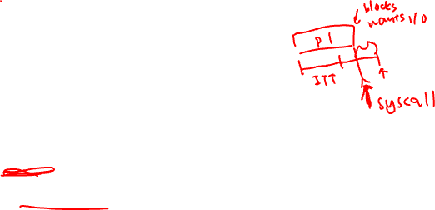
Question 3b
How to handle blocking of process for I/O or other events?
The process will block during its time quantum and only get switched out at the next timer interrupt. The CPU remains idle until the next timer interrupt.
When the process is blocked on I/O or any other system level events, the process needs to make a system call, i.e. OS will be notified.
Then OS can intercept such events and call the scheduler directly from the system call routines. The timer interrupt is not involved in this process.
Thus, the code should not be modified.

Slide 50
Question 4

Slide 51
Question 4
Briefly answer each regarding process scheduling, stating your assumptions if any.
a. Under what conditions does FCFS (FIFO) scheduling result in the shortest possible average response time?

Slide 52
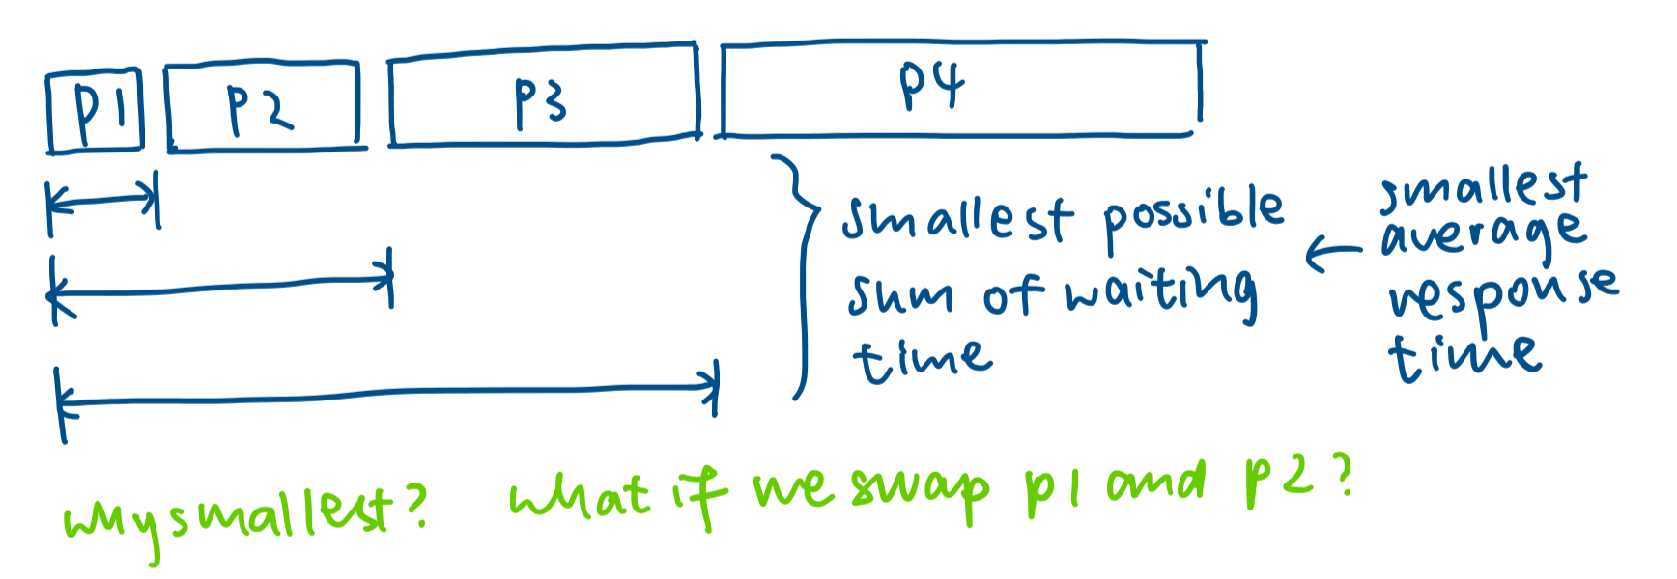
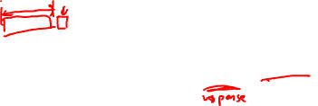
Question 4
Briefly answer each regarding process scheduling, stating your assumptions if any.
a. Under what conditions does FCFS (FIFO) scheduling result in the shortest possible average response time?
FIFO minimises the average response time if the jobs arrive in the ready queue in order of increasing job lengths. This avoids short jobs arriving later from waiting substantially for an earlier longer job. A special case also exists: when all jobs have the same completion time.

Slide 53
Question 4
Briefly answer each regarding process scheduling, stating your assumptions if any.
b. Under what conditions does round-robin (RR) scheduling behave identically to FIFO?

Slide 54
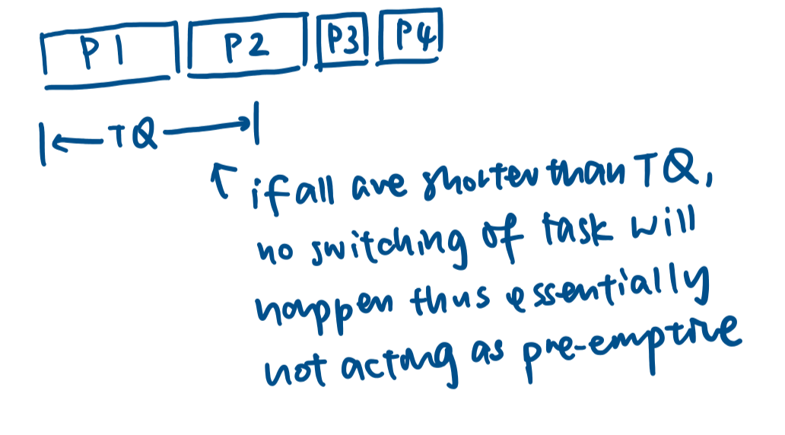
Question 4
Briefly answer each regarding process scheduling, stating your assumptions if any.
b. Under what conditions does round-robin (RR) scheduling behave identically to FIFO?
RR behaves identically to FIFO if the job lengths are shorter than the time quantum, since it is essentially a pre-emptive variant of FIFO.

Slide 55
Question 4
Briefly answer each regarding process scheduling, stating your assumptions if any.
c. Under what conditions does RR scheduling perform poorly compared to FIFO?

Slide 56
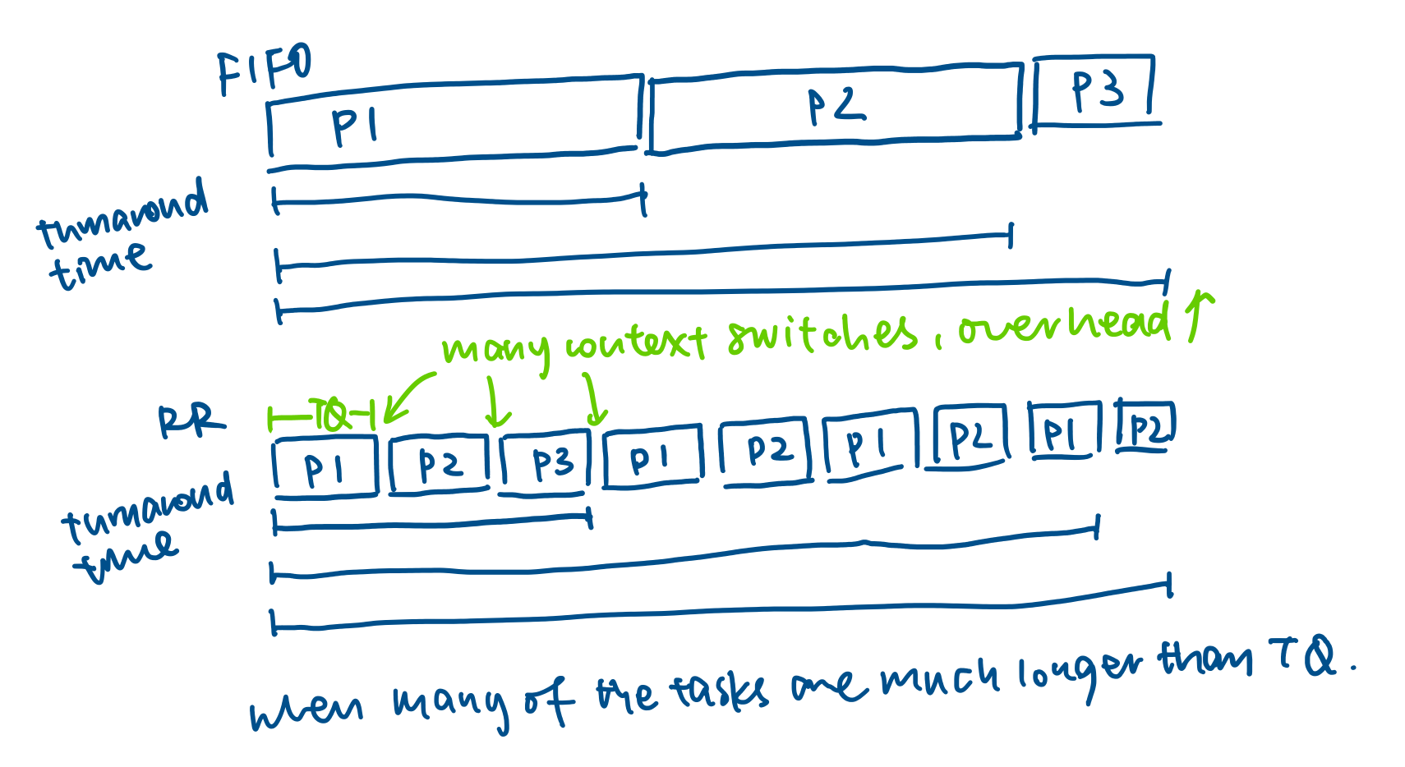

Question 4
Briefly answer each regarding process scheduling, stating your assumptions if any.
c. Under what conditions does RR scheduling perform poorly compared to FIFO?
Many possible answer:
When the job lengths are roughly the same and much greater than the time quantum, RR performs poorly in average turnaround time
When there are many jobs and the job lengths exceed the time quantum, RR results in reduced throughput due to greater overhead from the OS incurred due to context-switches when jobs are pre-empted

Slide 57
Question 4
Briefly answer each regarding process scheduling, stating your assumptions if any.
d. Does reducing the time quantum for RR scheduling help or hurt its performance relative to FIFO, and why? (Help = ✓, Hurt = ✖)

Slide 58

Question 4
Briefly answer each regarding process scheduling, stating your assumptions if any.
d. Does reducing the time quantum for RR scheduling help or hurt its performance relative to FIFO, and why?
Yes: reducing the time quantum increases the amount of CPU time spent by the OS performing context-switching, reducing throughput and increasing the average turnaround time
No: reducing the time quantum reduces the waiting time for a task to first receive CPU time, improving the initial response time (responsiveness)

Slide 59
Question 4
Briefly answer each regarding process scheduling, stating your assumptions if any.
e. Do you think a CPU-bound (CPU-intensive) process should be given a higher priority for I/O than an I/O-bound process? Justify your answers. (Yes = ✓, No = ✖)

Slide 60
Question 4
Briefly answer each regarding process scheduling, stating your assumptions if any.
e. Do you think a CPU-bound (CPU-intensive) process should be given a higher priority for I/O than an I/O-bound process? Justify your answers. (Yes = ✓, No = ✖)
Yes: CPU processes can be given higher priority for I/O so they may return to waiting for the CPU, decreasing overall turnaround time at the expense of response time of I/O-bound processes
No: maximise responsiveness of I/O-bound processes

Slide 61
Thank you!

